Slide 1
Basic Statistics for Data Science with Python
Nur Andi Setiabudi
Notes:
ID=d924773e-9a16-4d6d-9803-8cb819e99682 Recipe=text_billboard Type=TextOnly Variant=0 FamilyID=AccentBoxWalbaum_Zero

Slide 2

Food Tasting
Stir it well
Pick only small portion of it
Taste
Conclude
That was Statistics

Slide 3
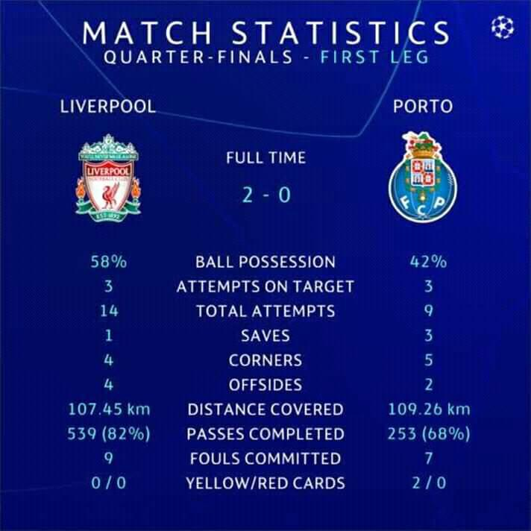


Slide 4

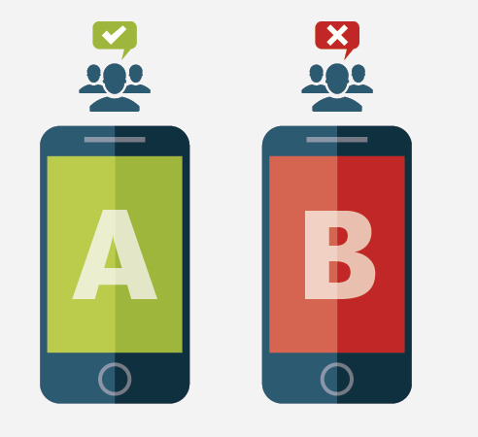
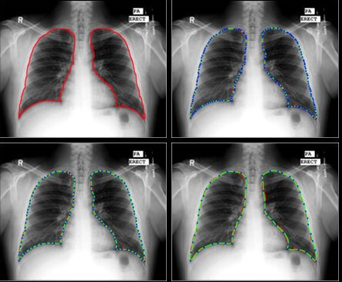




Slide 5

But, statistics (and also data science, of course) is not a magic

Slide 6
Definition

Slide 7
What is statistics?
The practice or science of collecting and analyzing numerical data in large quantities, especially for the purpose of inferring proportions in a whole from those in a representative sample – Oxford
The science of learning from data, and of measuring, controlling and communicating uncertainty – American Statistical Association

Slide 8
Basic steps in statistics
Studying a problem through the use of statistical data analysis usually involves four basic steps.
Defining the problem
Collecting/preparing the data
Analyzing the data
Reporting the results

Slide 9
Population and Sample

Slide 10
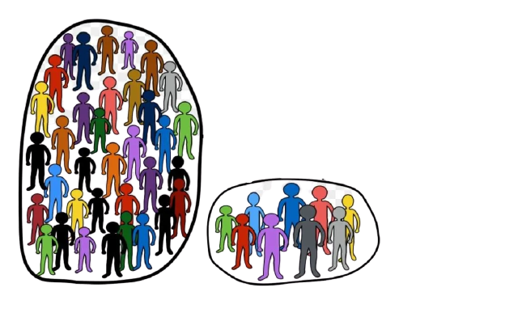

Statistics
Sampling
Descriptive
Inference
Sample
Population
(Unkown)
Technology make it possible to gather and analyze whole population

Slide 11
Population and sample
Data consists of information coming from observations, counts, measurements, or responses
A population is the entire group that you want to draw conclusions about.
A sample is the specific group that you will collect data from. The size of the sample is always less than the total size of the population.
Sample
Statistics
Population
Parameter
A parameter is a numerical description of a population characteristic.
A statistic is a numerical description of a sample characteristic.

Slide 12
Characteristics of good sample
Representative of population: should be an accurate representative of the universe from which it is taken
Random selection: should be selected at random. This means that any item in the group has a full and equal chance of being selected and included in the sample. This makes the selected sample truly representative
Sampling error can be quantified. Non sampling error is corrected for as much as possible
Economical: should be achieved with minimum cost and effort
Practical: should be capable of being understood and followed in the fieldwork

Slide 13
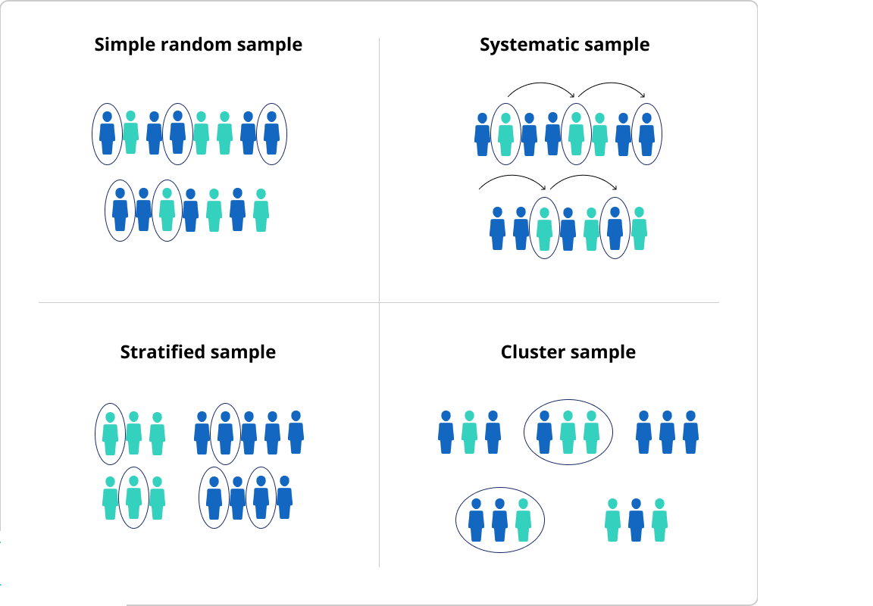
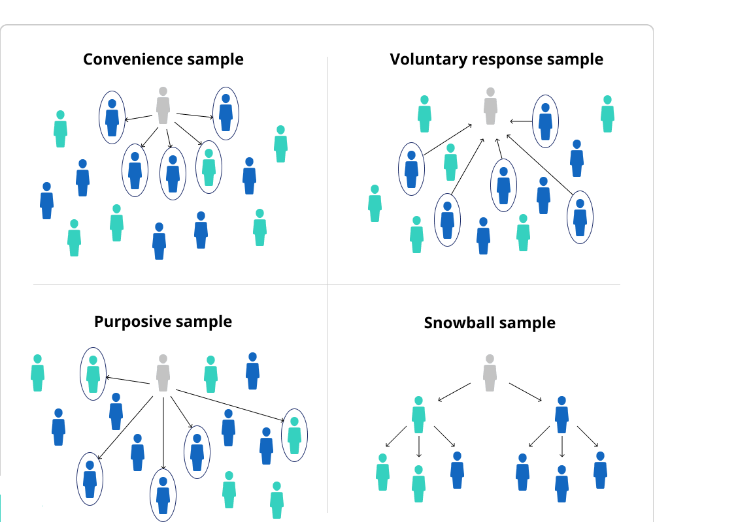
Sampling method
https://www.scribbr.com/methodology/sampling-methods/

Slide 14
Error and bias
Potential source of error in estimating population parameter using sample
Sampling error
Sample is not the whole population
Non-sampling error
Behavioral effect
Questionnaire and tools error
Poor sampling method

Slide 15
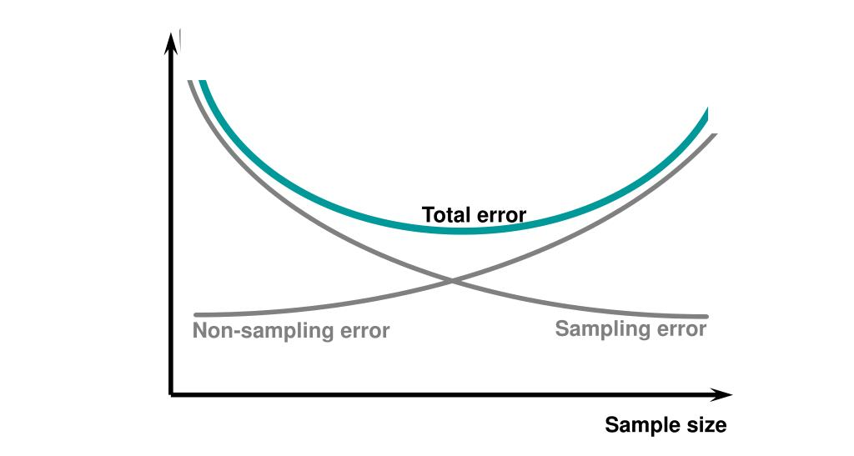
Error vs sample size

Slide 16
Two Branches of Statistics
Statistics
Descriptive statistics
Inferential statistics
Involves the organization, summarization, and display of data
Involves using a sample to draw conclusions about a population
Frequency, count
Basic measurements
Charts
Estimation
Hypothesis testing
Confidence Interval
Significance testing
Modeling

Slide 17
Descriptive Statistics

Slide 18
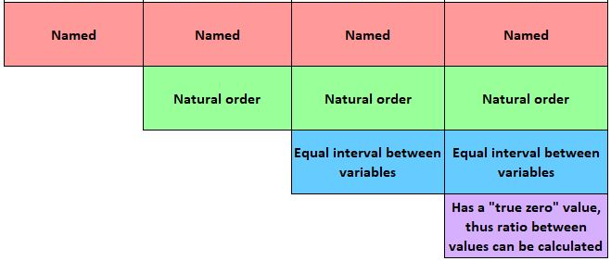
Measurement level
Qualitative
Quantitative
Nominal
Ordinal
Interval
Ratio
Color
Gender
Education
Satisfaction level
Temperature
Exam score
Age
Monthly income

Slide 19
Descriptive statistics
Descriptive statistics is the term given to the analysis of data that helps describe, show or summarize data in a meaningful way such that, for example, patterns might emerge from the data.
Descriptive statistics do not, however, allow us to make conclusions beyond the data we have analyzed or reach conclusions regarding any hypotheses we might have made.
They are simply a way to describe our data.
Measures of central tendency: these are ways of describing the central position of a frequency distribution for a group of data
Measures of spread (dispersion): these are ways of summarizing a group of data by describing how spread out the scores are

Slide 20
Measures of central tendency
ways of describing the central position of a frequency distribution for a group of data
Measure of Central Tendency | Appropriate to choose when … | Should not be used when…
Mean the balance point of a data distribution | No situation precludes it | Extreme scores Skewed distribution Ordinal scale Nominal scale
Median the midpoint of a data distribution | Extreme scores Skewed distribution Ordinal scale | Nominal scale
Mode score or category that has the greatest frequency | Nominal scales Discrete variables Describing shape | Interval or ratio data, except to accompany mean or median

Slide 21
Measures of dispersion
Summarizing a group of data by describing how spread out the scores are
Range: The interval between the highest and lowest measures
Percentile: The value below / above which a particular percentage of values fall
The standard deviation is a statistic that measures the dispersion of a dataset relative to its mean and is calculated as the square root of the variance

Slide 22
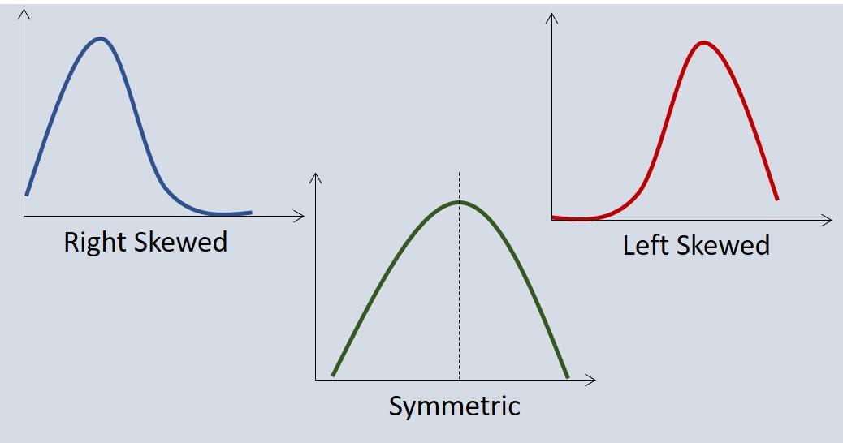
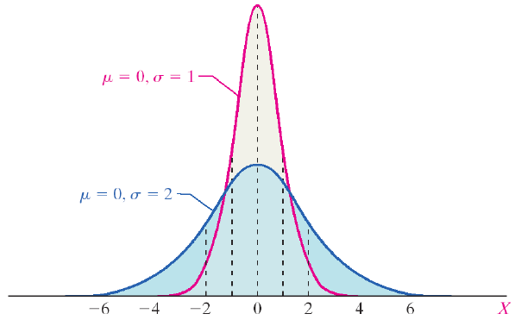
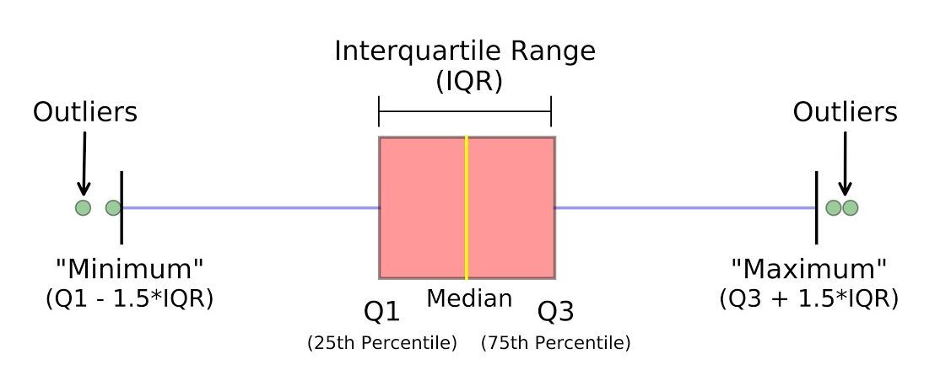
Data Distribution
Skewness
Central tendency
Small deviation
Large deviation
Histogram
Box Plot

Slide 23
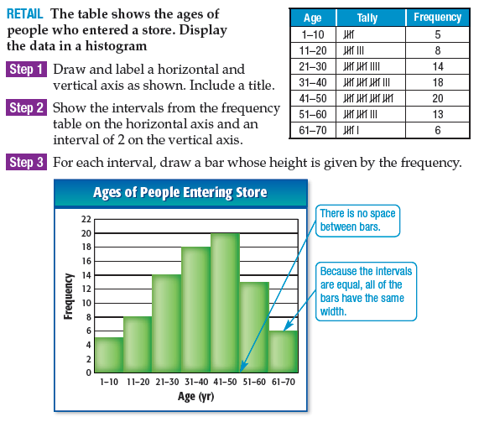
Presenting data: Table and chart

Slide 24
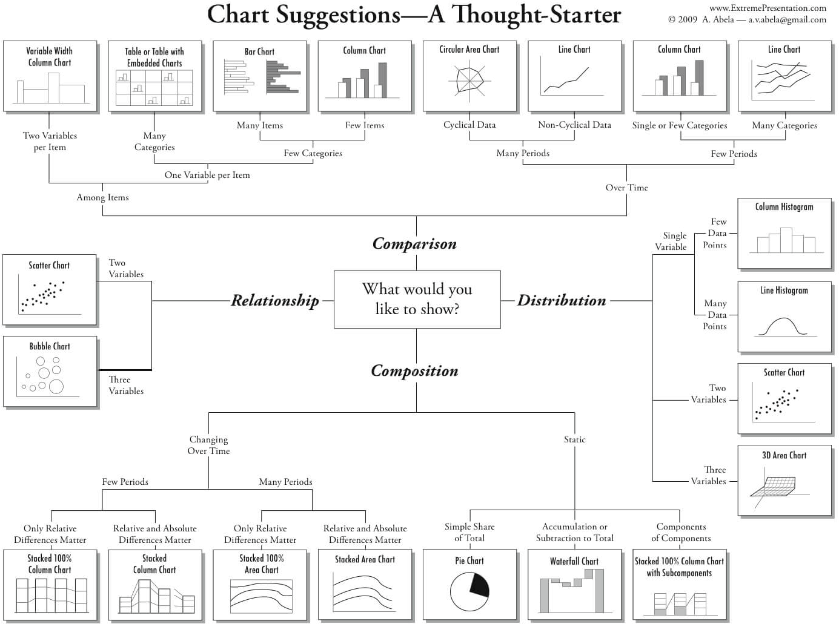
Presenting data: chart

Slide 25
Probability Distribution

Slide 26
Probability distribution terminology
Probability is the measure of the likelihood that an event will occur in a random experiment. It is quantified as a number between 0 and 1
A random experiment is a physical situation whose outcome cannot be predicted until it is observed
A sample space, is a set of all possible outcomes of a random experiment

Slide 27
Probability distribution terminology
A sample will form a distribution
The distribution provides a parameterized mathematical function that can be used to calculate the probability for any individual observation from the sample space
Data type:
Discrete: take only specified values
Continuous: take any value within a given range

Slide 28
Common data distribution
Many data conform to well-known and well-understood mathematical functions
Bernoulli: two possible values, eg. 0/1, success/fail, etc
Uniform: finite number of values are equally likely to be observed, eg. rolling dice
Binomial: n times random experiment of Bernoulli
Normal: represents the behavior of most of the situations in the universe
Chi-square, Poisson, Gamma, Exponential, etc

Slide 29
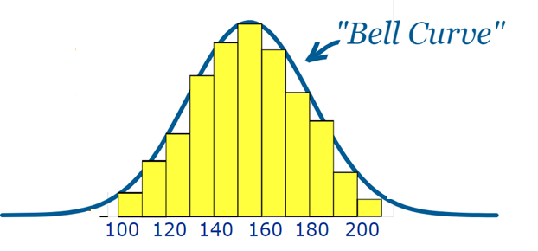
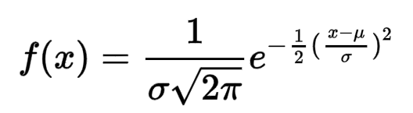
Normal (z) distribution
The Normal Distribution has:
mean = median = mode
symmetry about the center
50% of values less than the mean
and 50% greater than the mean
Outliers
Median
Mean
Mode

Slide 30
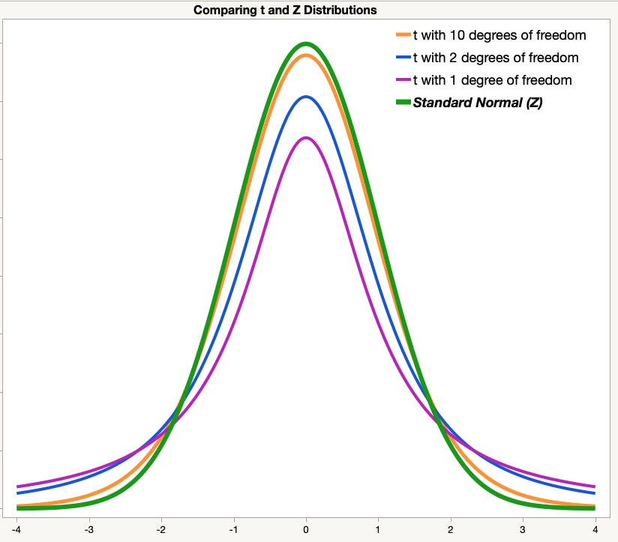
Student’s t distribution
Like a standard normal distribution (or z-distribution), the t-distribution has a mean of zero.
The normal distribution assumes that the population standard deviation is known. The t-distribution does not make this assumption.
The t-distribution is defined by the degrees of freedom. These are related to the sample size.
The t-distribution is most useful for small sample sizes, when the population standard deviation is not known, or both.
As the sample size increases, the t-distribution becomes more similar to a normal distribution.
jmp.com

Slide 31
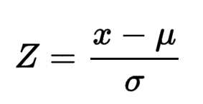
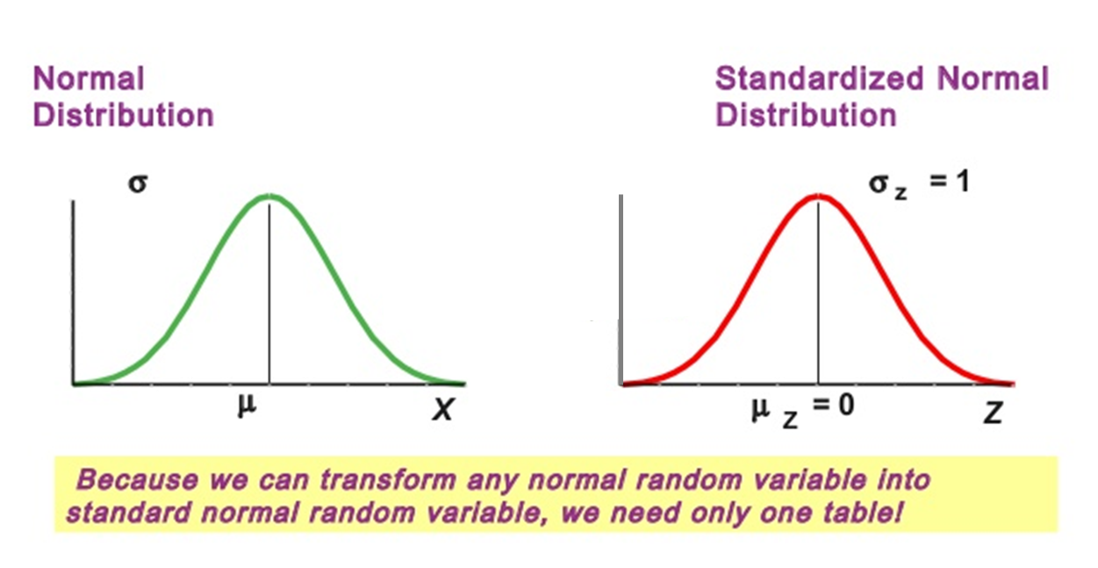
Standardized Normal distribution
Normal distribution
Standardized
Normal distribution
Area under curve = 1
(probability of all-possible events)

Slide 32
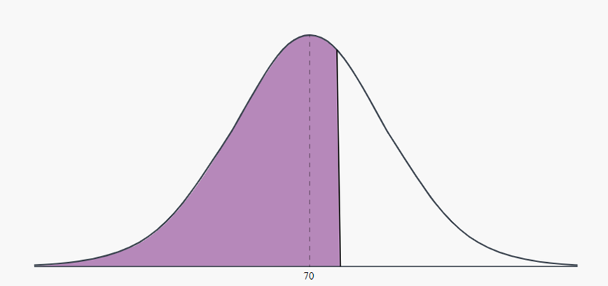
Calculate probability: example
Problem: The weights of adult-males are known to be normally distributed with a mean of 70 kgs and a standard deviation of 13 kgs. Find the percentage of adult-males with weights less than 80 kgs
70
80
0
Z
For X = 80 → Z = (80 – 70)/13 = 0.769
So, P(X < 80) = P(Z < 0.769)

Slide 33
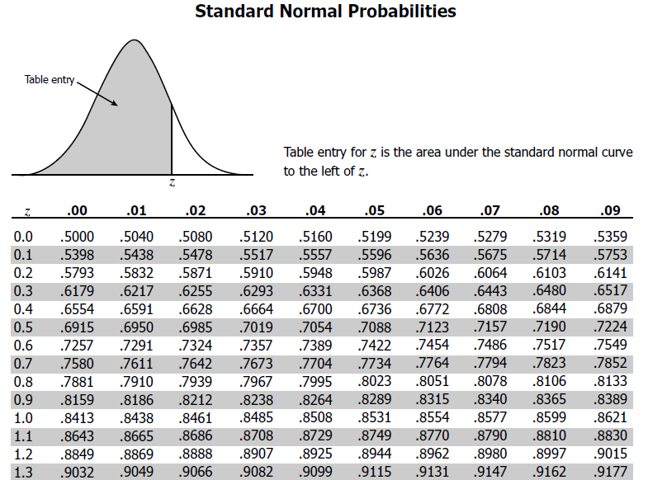
Calculate probability: example
0.7794
0
Z = 0.769
P(X < 80) = P(Z < 0.769) = 0.7794
The percentage of adult-males with weights less than 80 kgs is around 78%

Slide 34
Inferential statistics

Slide 35

Inferential statistics
Eight out of 10 owners said their cat prefers it
80% ?
How confident can we be about such statistic?
8 out of 10?
80 out of 100?
800 out of 1000?
80000 out of 100000?

Slide 36


Inferential statistics
Process to draw conclusions about some unknown aspect of a population based on a random sample from that population
Hypothesis testing
Confidence Interval
Significance testing
Statistic of
Sample
Or parameter estimator
Parameter of
Population
(Unknown)

Slide 37
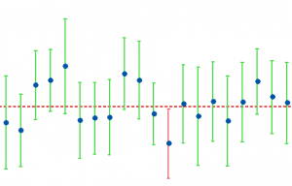
Confidence interval
A confidence interval calculates the probability that a population parameter will fall between two set values.
Confidence intervals measure the degree of uncertainty or certainty in a sampling method.
Most often, confidence intervals reflect confidence levels of 95% or 99%.
If we say that we are 95% confident that the unknown population mean is contained in this interval, then we are really saying that we found the interval using a method that is successful in giving correct results 95% of the time

Slide 38
Interpreting confidence interval
“In a sample of 659 parents with toddlers, about 85%, stated they use a car seat for all travel with their toddler. From these results, a 95% confidence interval was provided, going from about 82.3% up to 87.7%.”
we are 95% certain that the population proportion who use a car seat for all travel with their toddler will fall between 82.3% and 87.7%.
if we take a different sample from these 659 people, 95% of the time, the percentage of the population who use a car seat in all travel with their toddlers will be in between 82.3% and 87.7%.
95% confidence interval does not mean 95% probability
Towards Data Science

Slide 39
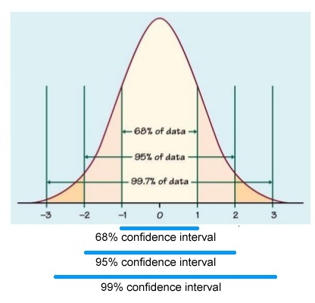
Confidence level vs confidence interval
The greater the confidence level, the wider the confidence interval

Slide 40
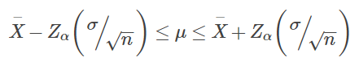
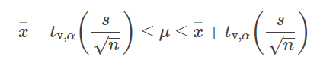
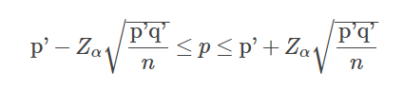
Confidence interval formula
Confidence interval for mean
Confidence interval for proportion
(Population variance known)
(Population variance unknown)

Slide 41
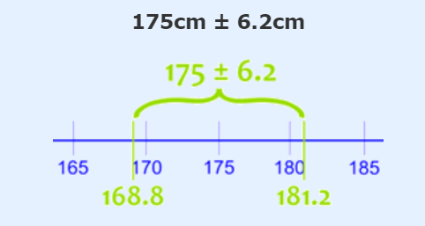
Confidence interval: example
Problem: We measure the heights of 40 randomly chosen men, and get a mean height of 175cm. We have already known that standard deviation is 20cm. Calculate the 95% confidence interval for mean height!
= 1.96 * (20/√40) = 6.2
This says the true mean of ALL men height is likely to be between 168.8cm and 181.2cm.

Slide 42
Hypothesis testing

Slide 43

Hypothesis testing
Hypothesis testing is a statistical method that is used in making statistical decisions using sample
Hypothesis Testing is basically an assumption that we make about the population parameter
Hypothesis is made before running the test
Null Hypothesis (H0)
Alternative Hypothesis (H1)
Assumes that the observation is due to a chance factor
Shows that observations are the result of a real effect
This is hypothesis that we propose
“Two website designs generate equal revenue”
“New website design generate more revenue than the existing one”

Slide 44
Hypothesis testing …
Null Hypothesis (H0)
Alternative Hypothesis (H1)
“Two website designs generate equal revenue”
“New website design generate more revenue than the existing one”
Collect sufficient evidence to reject H0 → accept H1
How sufficient is sufficient? → Confidence level (90%, 95%, 99%, ect.)
When reject H0, we conclude that H1 is true at certain level of confidence
We never accept H0. Instead, we say: No sufficient evidence to reject H0

Slide 45
Two types of error
 | Reject H0 | Fail to Reject H0
Reality: H0 is True | Type I error ( α ) | Correct decision Probability ( 1 - α )
Reality: H0 is False | Correct decision Power ( 1 - β ) | Type II error ( β )

Slide 46




Hypothesis testing: the court
Man
About 40s
180 cm tall
Black sedan
Souce: Rahul Patwari @ Youtube

Slide 47


Hypothesis testing: the court
Courtroom hypothesis
Innocent
Our job is to disapprove this
If innocent, very unlikely to find this evidence
until proven
Guilty
EVIDENCE
Alternative hypothesis
So we can accept this
HOW UNLIKELY?
50%: chance he’s innocent and we found that evidence
20%
5%
1%
Significant level (alpha)
Souce: Rahul Patwari @ Youtube

Slide 48



Hypothesis testing: the court
Judge doesn’t reject his innocent
CORRECT DECISION
Judge doesn’t reject his innocent
ERROR (Type II) : β
Judge reject his innocent
ERROR (Type I) : α
Judge reject his innocent
CORRECT DECISION
Souce: Rahul Patwari @ Youtube

Slide 49

There are un-avoidable errors in statistics
That’s why statistics is also defined as science of uncertainty
The role of statisticians is to quantify and minimize the error

Slide 50
Statistical test
Correlational: test an association or relationship between variables
Pearson Correlation | Tests for the strength of the association between two continuous variables
Spearman Correlation | Tests for the strength of the association between two ordinal variables
Comparison of Means: test the difference between the means of variables
T-Test | Tests for the difference between two group
ANOVA | Tests for the difference between group means (more than 2 groups)
Regression: test if change in one variable predicts change in another variable
Linear regression | Tests how change in the predictor variable predicts the level of change in the outcome variable
Logistics regression | Tests how change in the predictor variable predicts the level of change in the categorical outcome variable

Slide 51
Hypothesis testing steps
State the null hypothesis, H₀ and the alternative hypothesis, H₁
Choose an alpha α, our significance level
Select a statistical test, and calculate the observed test statistic
Find the critical value of the test statistic ( and/or p-value)
Compare the observed test statistic with the critical value, (or compare the p-value with α), and decide to accept or reject H₀

Slide 52
Two and one-tailed hypothesis testing
H₀: μ = 15.00
H₁: μ ≠ 15.00
H₀: μ ≥ 15
H₁: μ < 15
H₀: μ ≤ 15
H₁: μ > 15
Two-tailed
One-tailed

Slide 53
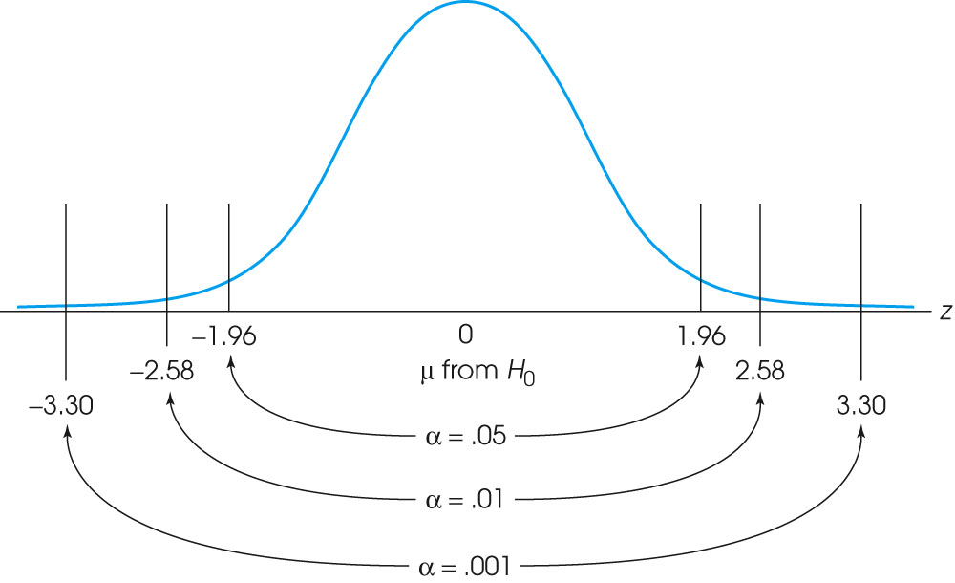
Alpha/significance level

Slide 54
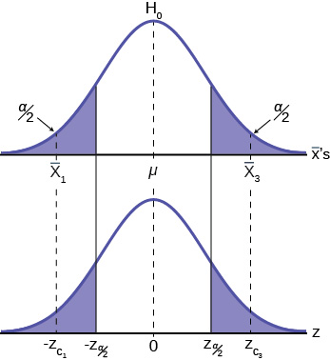
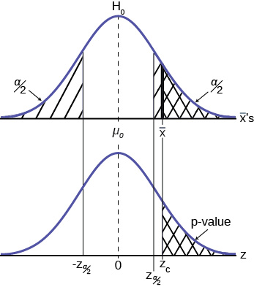
Alpha, critical value, test statistic and p-value
Rejection region
Test statistic

Slide 55
Making conclusion
If test statistic is large enough to be in the critical region, we conclude that the difference is significant or that the treatment has a significant effect. In this case we reject the null hypothesis.
If the mean difference is relatively small, then the test statistic will have a low value. In this case, we conclude that the evidence from the sample is not sufficient, and the decision is fail to reject the null hypothesis

Slide 56
Hypothesis testing about mean
One sample:
Z test if population variance is known
Z test if population variance is unknown

Slide 57
Hypothesis testing about mean
Two samples
Both variances are unknown, but assumed equal)

Slide 58
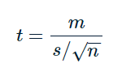
Hypothesis testing about mean
Two paired samples
Since m is mean of pairwise difference between two-sample, we can simply apply standard one-sample T-Test

Slide 59
Hypothesis testing about proportion
One sample proportion
Comparison of two-proportions

Slide 60
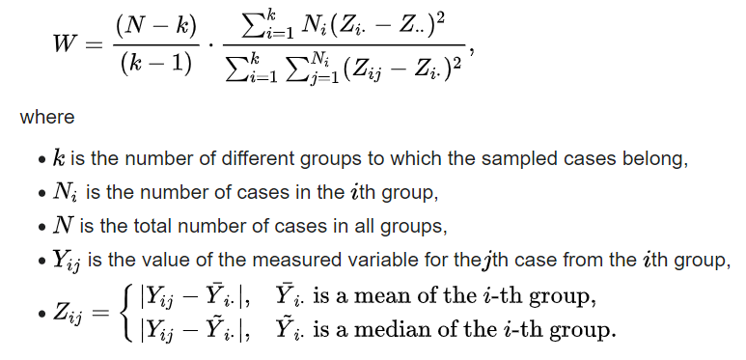
Levene’s test
Inferential statistic used to assess the equality of variances for a variable calculated for two or more groups
Often used before a comparison of means

Slide 61
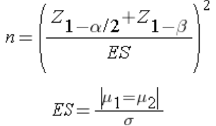
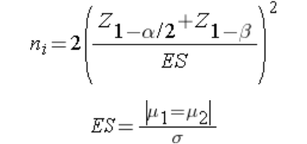
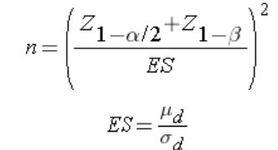
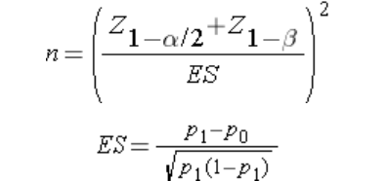
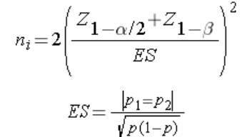
Sample size to conduct hypothesis testing
One sample
Two independent sample
Two paired sample
One sample proportion
Two ind. Sample – proportion

Slide 62
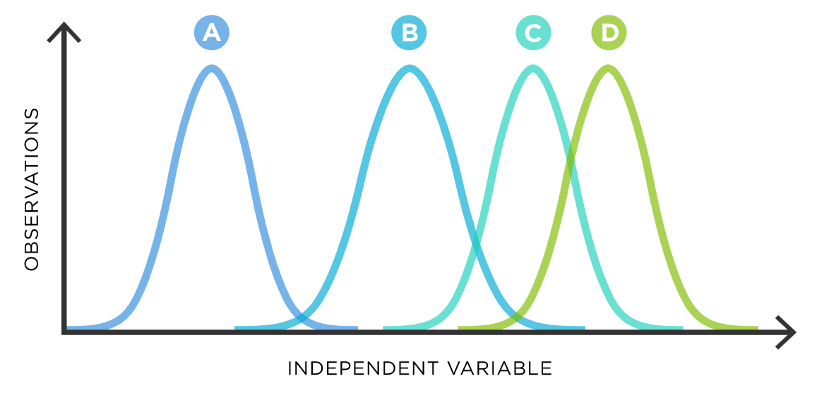
ANOVA – Analysis of Variance
ANOVA is a statistical technique that is used to check if the means of two or more groups are significantly different from each other.
When we have only two samples, t-test and ANOVA give the same results
If we conduct multiple t-tests for comparing more than two samples, it will have a compounded effect on the error rate of the result
ANOVA uses F-tests to statistically test the equality of means.
H₀: μ₀ = μ₁ = … = μ_{m}
H₁: at least one μ is unequal

Slide 63
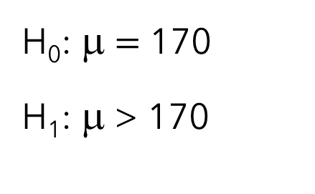
Hypothesis testing: example
Problem: We measure the heights of 40 randomly chosen men, and get a mean height of 175cm. We have already known that standard deviation is 20cm. With alpha 5%, can we conclude that mean height of ALL men is greater than 170cm?
H₀: μ $=$ 170
H₁: μ > 170
Critical value: z > 1.645
Test statistic: (175−170)/(20/√40) = 1.581
Test statistic is less than critical value, so we failed to reject H_{0,} and conclude that there are not sufficient evidences that population mean of men’s height is more than 170cm

Slide 64
Correlation

Slide 65
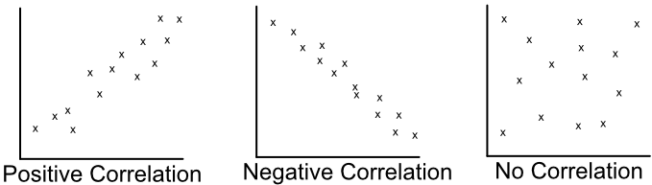
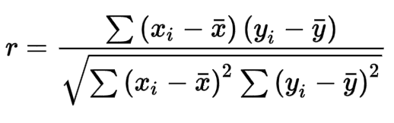
Correlation
Correlation is a statistical technique that can show whether and how strongly pairs of numerical variables are related
Denoted by a correlation coefficient (or "r"). It ranges from -1.0 to +1.0.
The closer r is to +1 or -1, the more closely the two variables are related
Pearson’s correlation:

Slide 66
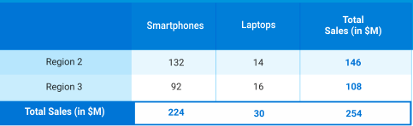
Association
The Chi-Square Test of Independence determines whether there is an association between categorical variables
This test utilizes a contingency table (also known as cross-tabulation, crosstab, or two-way table) to analyze the data

Slide 67
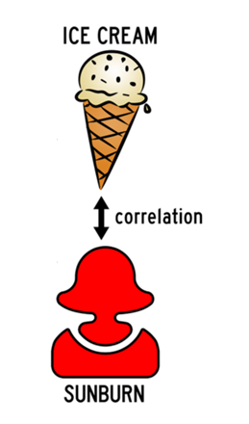
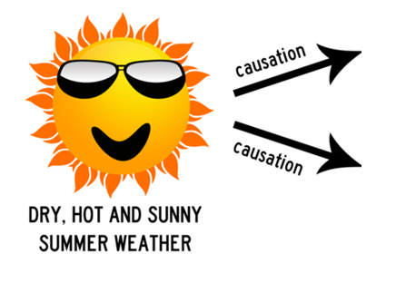
Correlation does not imply causation
Seeing two variables moving together does not necessarily mean we know whether one variable causes the other to occur.
It may be the result of random chance, where the variables appear to be related, but there is no true underlying relationship
There may be a third, lurking variable that that makes the relationship appear stronger (or weaker) than it actually is
...but with well-designed empirical research, we can establish causation!
So, how do we explore causation? With the right kind of investigation!

Slide 68
Regression

Slide 69
Statistical modeling
Supervised
Linear Regression
Unsupervised
K-Mean clustering
Logistics Regression
Naïve Bayes classification
Decision tree
Discriminant analysis
…
Hierarchical
K-Median
Hidden Markov model
…
Time series
ARIMA
ARCH model
Auto Regression
Moving Average
…
The majority of the problems in statistical inference can be considered to be problems related to statistical modeling
-- Konishi & Kitagawa (2008)

Slide 70
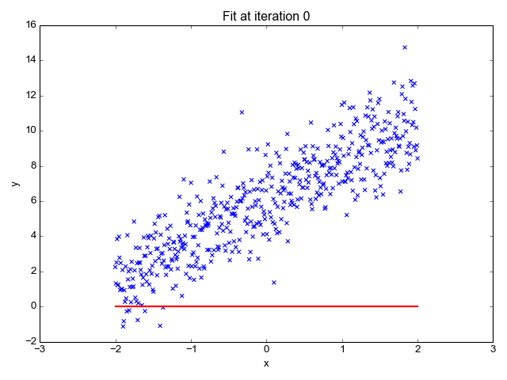
Regression
Linear regression is a basic and commonly used type of predictive analysis.
In regression, we examine:
does a set of predictor variables do a good job in predicting an outcome (dependent) variable?
Which variables in particular are significant predictors of the outcome variable, and in what way do they impact the outcome variable?

Slide 71
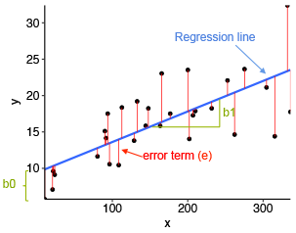
Regression
Regression is one types of statistical modeling
The goal of is to adjust the values of the model's parameters to find the line or curve that comes closest to your data
Simple:
y = b₀ + b₁ x + error
Multiple:
y = b₀ + b₁ x₁ + b₂ x₂ + … + error
We then use statistical inference to test whether regression coefficients (b0, b1, b2, …) are significant

Slide 72
Regression
Regression only accepts numerical variables for both predictors and response
Categorical variable can be use as predictors after be transformed into dummy variables
Significance of whole model → F test (ANOVA), Significance of each predictors → t-test
R-Squared (or Adjusted R-Squared) is commonly used to quantify the goodness of the model

Slide 73
Regression
Assumptions for linear regression and ANOVA
Each group sample is drawn from a normally distributed population
All populations have a common variance (homoscedasticity)
All samples are drawn independently of each other
Within each sample, the observations are sampled randomly and independently of each other (no auto-correlation)
No correlation between predictors (no multicollinearity)

Slide 74
Exercise

